Slide 1

JIRA TOOL DEMO FOR DELIVERY EXCELLENCE TEAM

Slide 2
Table of Contents
a. Key Capabilities & terminologies of JIRA
b. JIRA Project creation and setup
c. SCRUM Template - Configuration | Planning | Tracking | Reporting
d. Issue Type - Attribute , Basic work flow configuration
e. Basic Automation Rules
f. BOARD creation, Backlog grooming and Planning
g. Sprint Creation | Issue and Sub task creation
h. Estimation and Time Tracking
i. Basic JIRA Reports and Dashboards
j. How Jira can be configured for projects
k. Understand the JIRA operations for Agile Projects

Slide 3
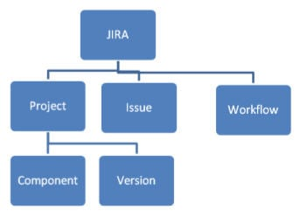
What is JIRA? Atlassian JIRA is an issue and project tracking software to plan, track and manage your projects. JIRA is mainly used by agile development teams to customize your workflows, team collaboration, and release software with confidence Basics Of JIRA Tool: JIRA in its entirety is based on 3 concepts. Issue: Every task, bug, enhancement request;basically anything to be created and tracked is considered an Issue. Project: A collection of issues Workflow: A workflow is simply the series of steps an issue goes through starting from creation to completion.

Slide 4
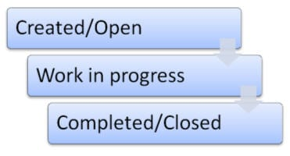
Say the issue first gets created, goes to being worked on and when complete gets closed. The workflow in this case is:

Slide 5
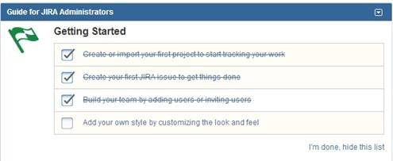
JIRA Admin And User Management
Project Management is one of the first and most important concepts in administration. A JIRA Admin can:
Create a project
Configure an already created Project.
Create A Project
1) Once you log in, on the Dashboard itself you will have a few options to get started:

Slide 6
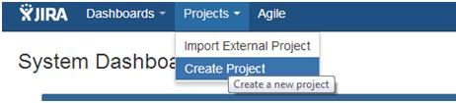
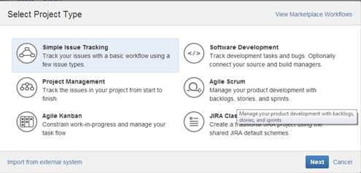
You can either click on the item in the list or you can choose:
Or go to the Administration->Projects menu option: And then on this page, you will have an option to “Add Project”
#3) Choose any of the above 3 methods to add a project. In the below window, choose the type of Project. The Project type will determine the type of workflow your issues will go through.

Slide 7
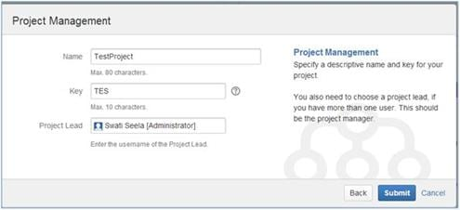
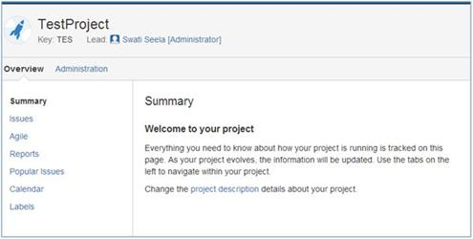
#4) Enter the Project Name, Key (once chosen cannot be changed) and assign a Project Lead (the person who is responsible for the overall project). Click Submit when done.
#5) The project gets created and the following details are displayed. By going to the “Administration” link you will be able to configure the project (in case of an already configured project, you can edit the configurations).

Slide 8
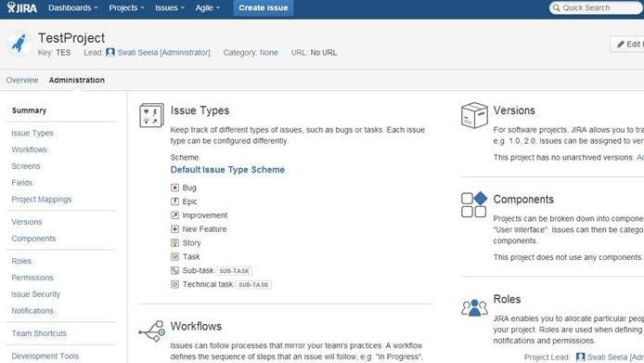
Configuring A Project
As you can see below, you can choose the issue types that need to show up, the workflow that the project follows, versions and components, people involved and the level of access permissions they have, etc.

Slide 9
User Management In JIRA
User creation is the most important part of the User Management process, it is not limited to just that.
The important user-related activities performed by a JIRA Admin are:
Edit a particular user information
Delete a user
Creating users groups
Creating Roles
Permissions
Setting Preferences
We will see the creations, deleting and editing of an issue in detail below.

Slide 10
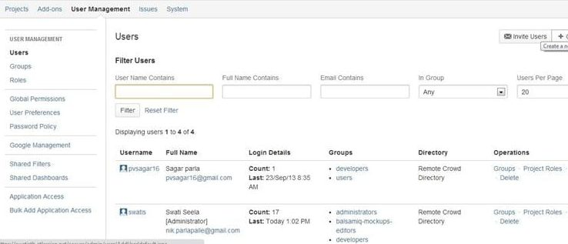
Firstly, Go to Administration->User Management: There are two ways to which you can add users to JIRA.
Create them manually.
Send an invite to join JIRA to a user’s email ID
Let us look at creating manually in detail:
#1) Click on Create User button in the below page:

Slide 11
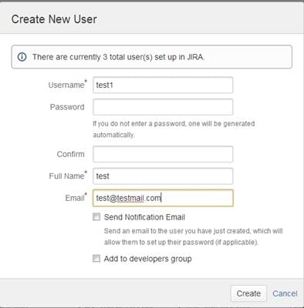
#2) Enter the user details in the “Create New User” dialogue that opens up. In the below example I have entered only mandatory fields. The others are self-explanatory and can be set as required.

Slide 12
#2) Enter the user details in the “Create New User” dialogue that opens up. In the below example I have entered only mandatory fields. The others are self-explanatory and can be set as required.

Slide 13
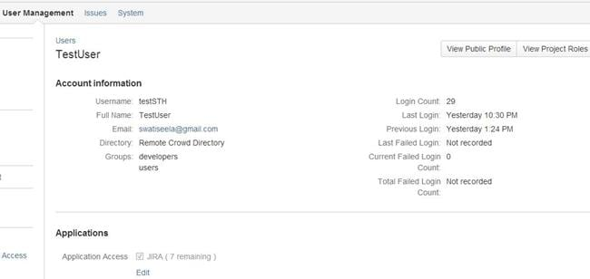
#3) On Clicking create, the user gets added and the following confirmation page comes up for the user.
An email is sent to the ID provided to the user with the information on how to set up a password that would enable the user to login and use JIRA.

Slide 14
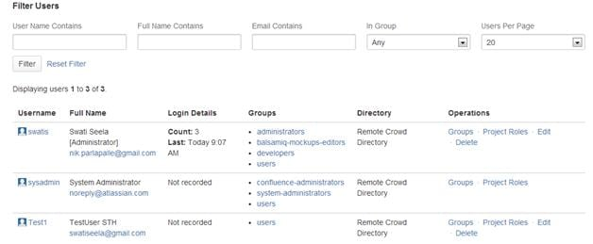
Editing A User
#1) Go to the User Management -> Users page. All the users available will be displayed. The top portion of this page contains a “Filter” section. This can be used to manipulate how/what user information needs to be displayed. You can choose to keep it empty, in which case it displays all the users available.
#2) Below the filter is a list o fusers organized in a tabular form is displayed.

Slide 15
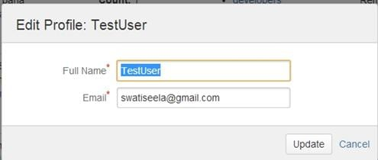
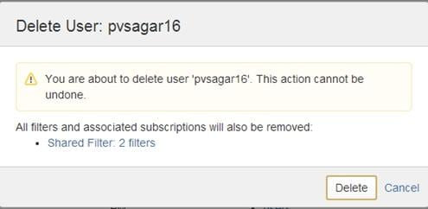
#3) Note the “Edit” link in the “Operations”
column.
Click on the corresponding “Edit” link for the
user whose information is to be modified.
You will be able to change
the following profile information.
Delete A User
Choose the “Delete” link corresponding to the user
you would like deleted from JIRA.
The following confirmation message is displayed
And you can choose to delete a user or
cancel the operation.

Slide 16
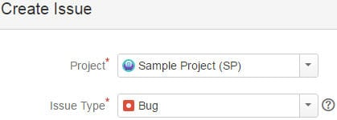
The Best Features Of JIRA Bug Tracking Tool
#1) JIRA treats all work inside it as an Issue
So, in JIRA to create a defect would be to create an issue of the
type “Bug”.
#2) Defect reporting needs the following information recorded for every issue:
Defect ID
Defect title
Defect description (steps to reproduce)
Environment information
Screenshot(attachment)
Severity
Assign it to someone
Status- All the statuses in the bug life cycle
All the options are available to be able to create a defect effectively.

Slide 17
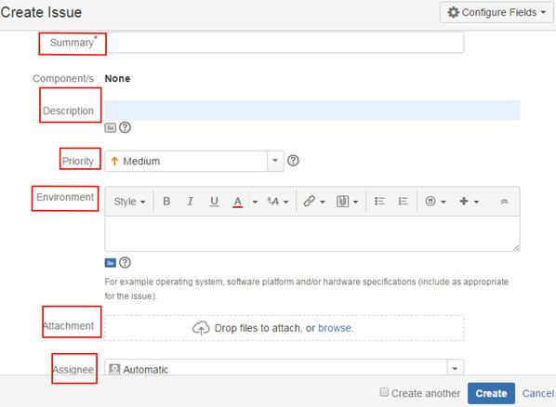
The two fields you are not seeing here are:
Defect ID
Status
These two fields are auto-created by JIRA. All issues will have a unique ID assigned to them by JIRA. Status of all issues is “To-Do” or “New” in JIRA by default on creating a bug.

Slide 18
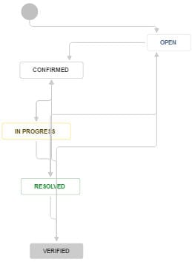
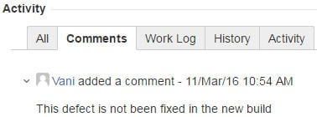
#3) Defect Life Cycle:
All bug life cycle statuses as in any other popular bug tracker)
can be accomplished here too:
#4) Comments and collaboration with the Dev Team
Every issue, its updates, people assignment, comments received from the Dev team – everything is tracked in JIRA under the activity log.
This allows for better visibility and collaboration with the development teams:

Slide 19
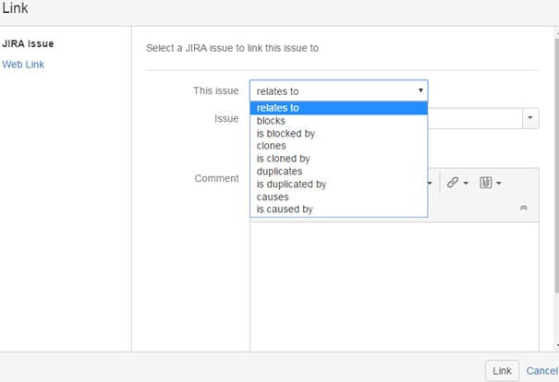
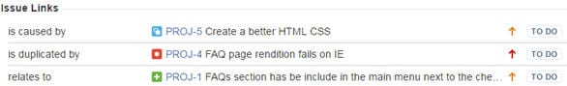
#5) Linking the defect to a requirement to enable traceability
Link option in the JIRA issue fields lets you link a particular issue to another one.
The resulting links will appear in the issue details page as below:

Slide 20
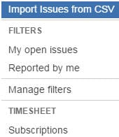
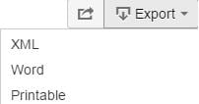
#6) Defects can be imported from a CSV file
This aids the bulk creation of issues in JIRA at once.
Also, if your team is new and you don’t want them creating issues directly into the tool, you can have them report the defects
in an excel sheet. Once they are reviewed and
confirmed as valid, they can be imported all at once
into the tool using this functionality.
#7) Defects can be exported into Word, XML, and printable formats

Slide 21
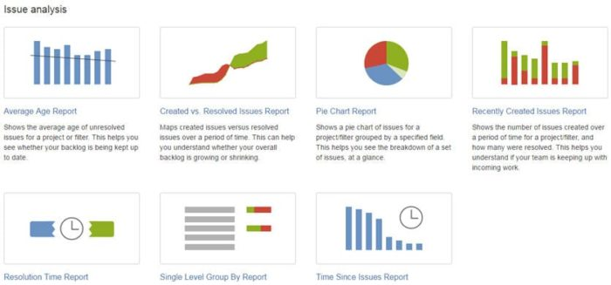
#8) Comprehensive Issue Reports:
In addition, if you need reports go to “Project – reports” and generate all sorts of reports as below:

Slide 22
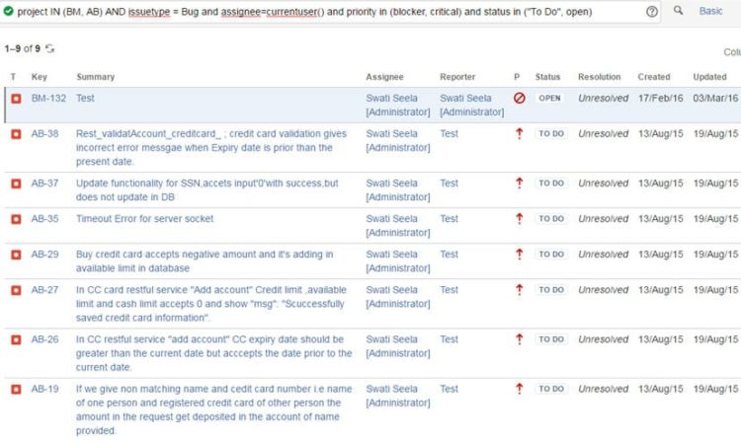
Advanced/Power users of JIRA can also create advanced search filters to generate deeper insights.
For example, if want to look at all the defects assigned to you across multiple projects (BM and AB), you could use a JQL query like below:

Slide 23
Creating A Jira Issue And Various Fields (Jira Issues: Different Types of Jira Issues)
Issues can be of different types and given below are the Description/meaning of Issue types:
Bug: This is any defect or deviation that is found in the application.
Enhancement request: It is also known as a change request (CR). This type is used to depict any change in the existing functionality or altogether a new functionality.
Task: This is more of a configuration or analysis issue. For Example, setting up proper configurations can be a task.
Question: Issue can be as simple as asking a question about how to use some functionality in the application. This type is more often used by the end customers.
Epic: This is normally a huge issue which is ideally broken done into several small issues. It can take several sprints to complete the main epic issue in an agile environment.
Financial Object: Often project/product management uses this type of issue to track their finances.
Story: Entire user story about a feature could be a type of issue.
Test case: Issue can be a test case. This type of issue will be available once Jira is integrated with plug-ins like Zypher.

Slide 24
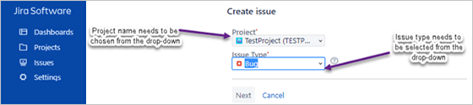
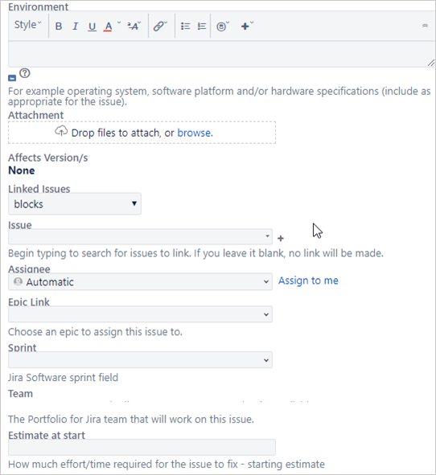
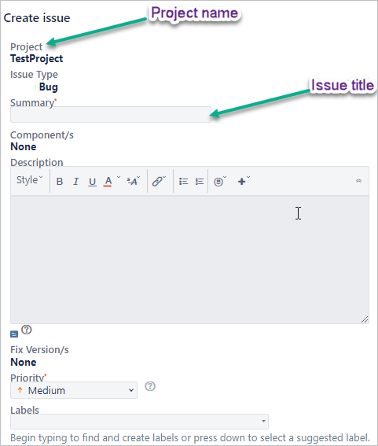
Creating an Issue
Assuming that a user has logged into Jira and
the desired project.
Step 1:Click on ‘+’ (‘Create’) toolbar button.
On this page, select project and issue/request
type and then click on the ‘Next’ button
Step 2:Enter the mandatory details and
other data as much as possible on the ‘Create issue’ page.
Step 3:Click on the ‘Create’ button. This will generate
a unique issue ID. ID will consist of project identifier
concatenated with numeric digits.

Slide 25
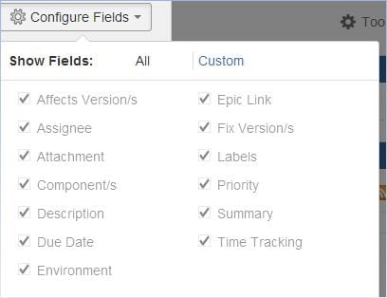
Additional Details About the Create Issue Page
1) There will be a configure fields option found on the top-right corner of the “Create Issue” page.
2) At the bottom of the “Create Issue” page, there is a “create another”
When you choose this option and click “Create”- once, the current issue is created; JIRA keeps the
“Create Issue” dialogue open with Project, Issue type and other fields except summary auto selected as per the previous issues created.

Slide 26
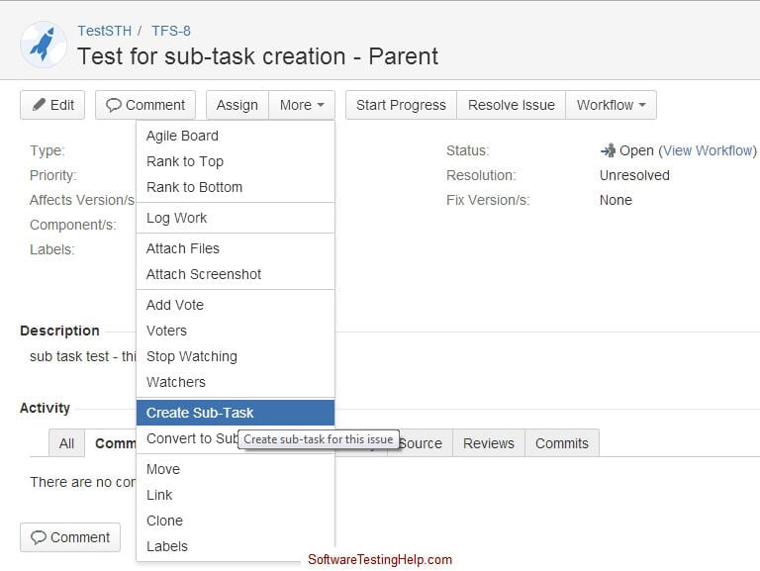
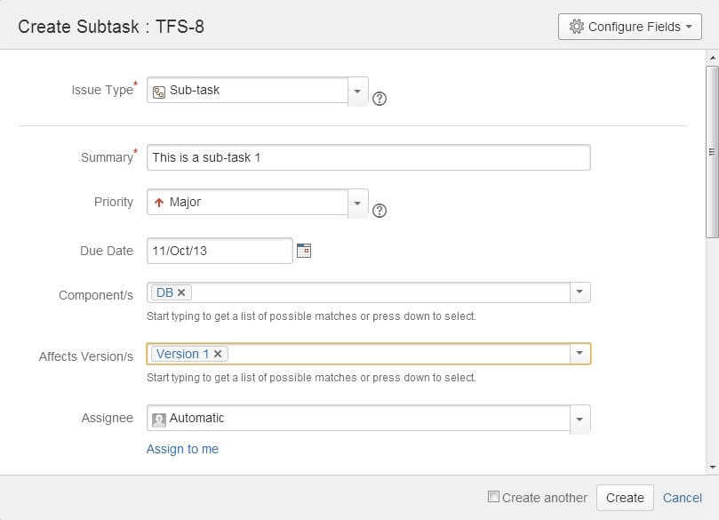
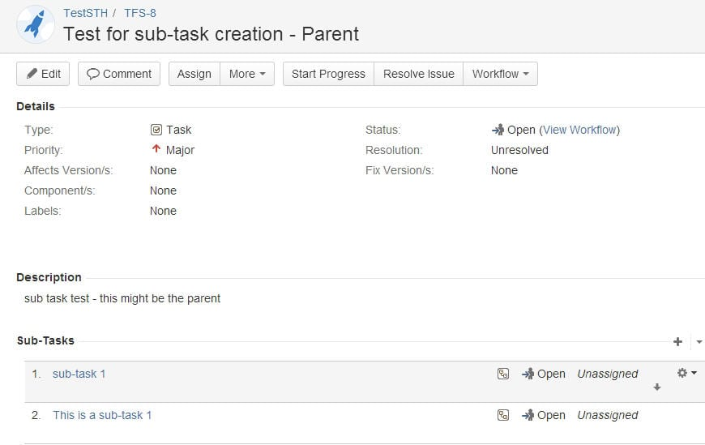
Jira – Subtasks: You can create Sub-tasks by following one of the two methods:
Create a sub-task to an issue, or
Convert an issue to a sub-task and choose a parent
Method 1: Creating a Sub-task under a parent issue

Slide 27
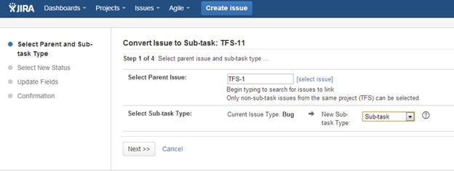
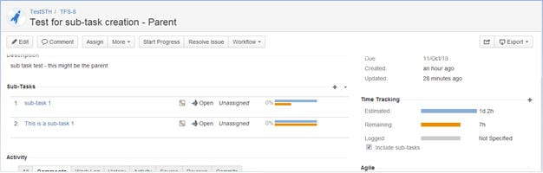
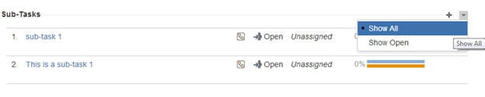
Method 2: Converting an issue into a sub-task
#1) Open a created issue. Go to the “More” drop-down list
and choose the “Convert to Sub-task” option.
For an issue with sub-tasks, the “Time tracking” portion will
display the consolidated time of the parent + the sub-tasks.
In the sub-tasks section, you can choose to display
all the Sub-tasks or just the ones that are
open by clicking on the down-arrow next to the “+” sign.

Slide 28
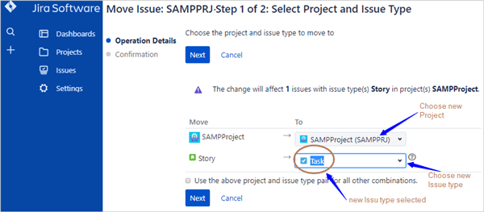
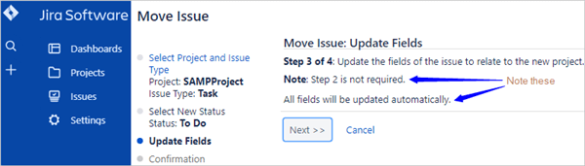
Move An Issue
1) Open (search) the issue which needs to be changed
(moved).
2) Click on the ‘on ‘…‘ button (referred to as ‘ellipsis’,
available at the top right-hand corner) so that
the drop-down menu gets expanded.
3) Select the ‘Move’ menu item. This will display the
‘Move Issue’ page, which shows Step1 of the two-step procedure.
#4) Step1. Select a new project where the issue is to be and
Select new issue type, from the drop-down in the ‘To’
column.

Slide 29
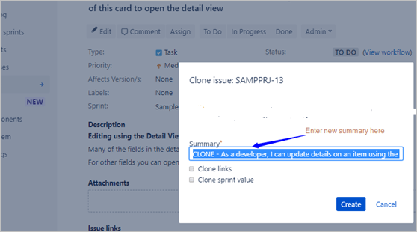
Clone An Issue
#1) Open (search) the issue which needs to be changed (moved).
#2) Click on the ‘on ‘…‘ button (referred to as ‘ellipsis’, available at the top right-hand corner) so that the drop-down menu gets expanded.
#3) Select the ‘Clone’ menu item. This will display the ‘Clone Issue’ page on top of the original issue.
In the mandatory summary field, enters a new summary for the new issue.Select ‘Clone links’ checkbox, if the linked issues are also to be copied (as links) to the new issue.Select ‘Clone sprint value’ checkbox, if the issue is to be added to the same Sprint as that of the original issue.
#4) After entering/selecting mandatory and
additional details click on the Create’ button.
This will create a new issue.

Slide 30
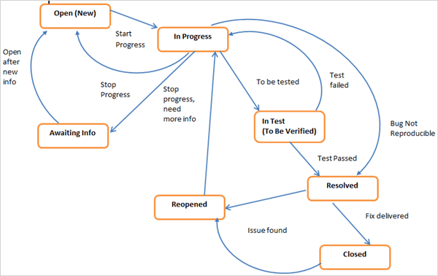
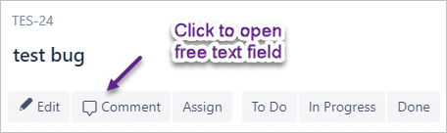
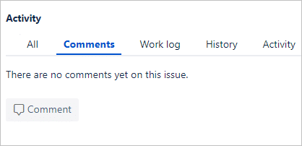
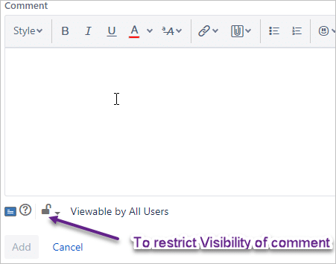
Managing Issue Workflow
Comments On Jira Issue

Slide 31
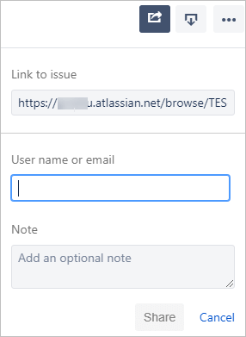
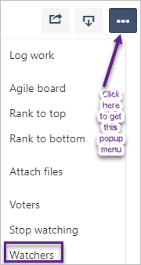
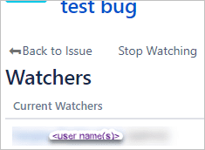
Email
Watch Issue

Slide 32
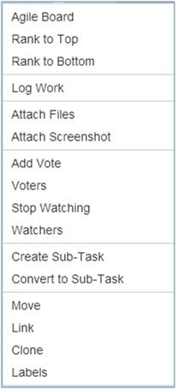
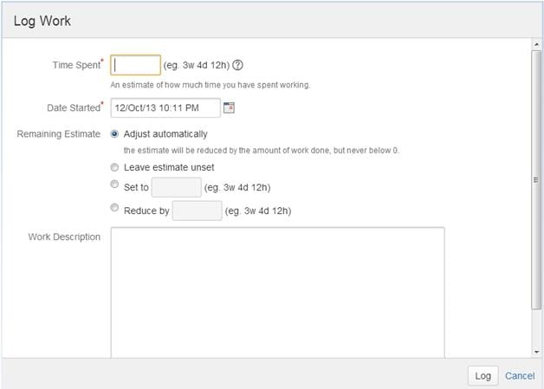
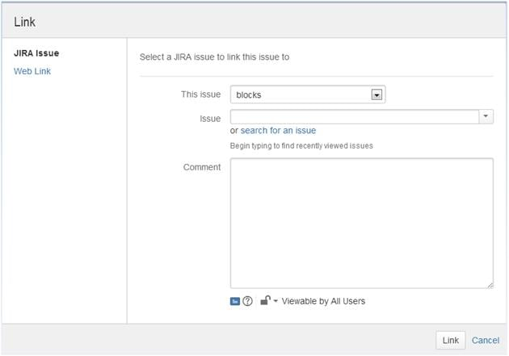
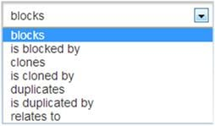
#5) Log work: This is a way to track the progress on your issue in terms of time. When this option is used, the following dialogue opens up. As you can see, the detailed information about how much time is spent on an issue, how much is remaining, etc can be logged here.
More menu item
#7) Link: This is a very versatile feature of JIRA that allows you can logically link issues with one another and establish relationships/dependencies.

Slide 33
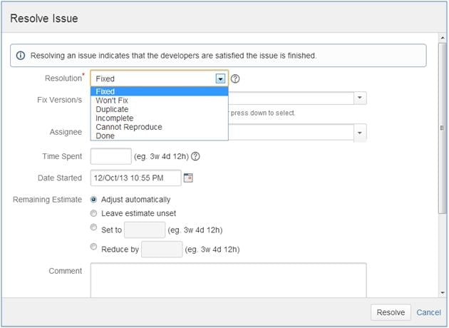
Resolve Issue:

Slide 34
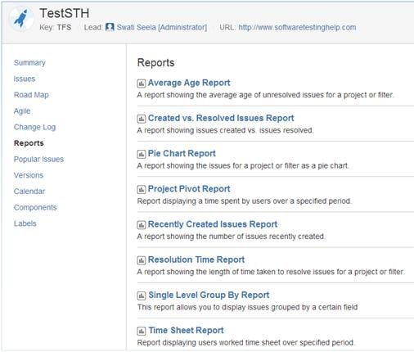
JIRA Reports
JIRA also comes with a robust reporting feature. There are many kinds of reports that it facilitates.
Browse through a project whose details you would want to get a report of and go to the “Reports” tab. Here you will see a list of all the reports that can present for you.
Choose the report and set the data criteria and you will have a custom made the report in hand within no time.

Slide 35

Installing JIRA Agile
The easiest way to get JIRA Agile is to install it directly from JIRA, via the Universal Plugin Manager (UPM). To do this, you will need to have an account with JIRA System Administrator global permission, and perform the following steps:

Slide 36



Slide 37


Slide 38

User stories

Slide 39


Slide 40


Slide 41


Slide 42


Slide 43

Scrum Handling With Jira For Managing The Sprint

Slide 44


Slide 45


Slide 46


Slide 47


Slide 48


Slide 49


Slide 50


Slide 51


Slide 52


Slide 53


Slide 54


Slide 55

JIRA Dashboard

Slide 56


Slide 57


Slide 58


Slide 59


Slide 60


Slide 61


Slide 62



